Slide 1
Weekend Navigator Session 1: The basics
Notes:
Photos and illustrations used with permission from Mc Graw Hill Education

Slide 2
WN Introduction
Registration
Contact numbers
Facility Rules
Class Schedule
Student Guide
Topic Presentation
Tools
Notes:
Inform the students that this presentation doesn't follow the text’s presentation of the basic navigation elements. The text is fairly non- linear, while these first two sessions are more traditional in the presentation sequence. Students can keep oriented as to the topic’s location in the text by the Figure numbers given for the images.
Abbreviations and acronyms used in this presentation are taken from the WN text if given (e.g., nautical miles as “nm” and waypoint as “WPT”). Others, such as “Lat.” for latitude and “Long.” for longitude, are taken from Chapman.
The abbreviations for high tide (high water-HW) and low tide (low water-LW) are taken from the NOS Tide Table book.
While Bowditch, the traditional reference, is readily available online (http://www.irbs.com/bowditch/ ) and in nautical bookstores, Chapman is the more widely recognized publication by the public.

Slide 3
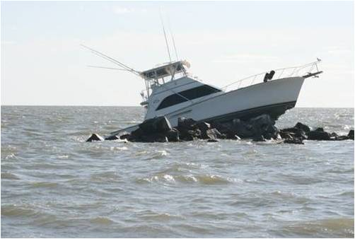
Let’s Avoid this Situation
Notes:
Image taken from shore of a 42’ Sport Fisherman grounded off Hampton VA during a night cruise. One of the people who worked for the commercial operator to salvage the vessel is also an Auxiliarist.

Slide 4
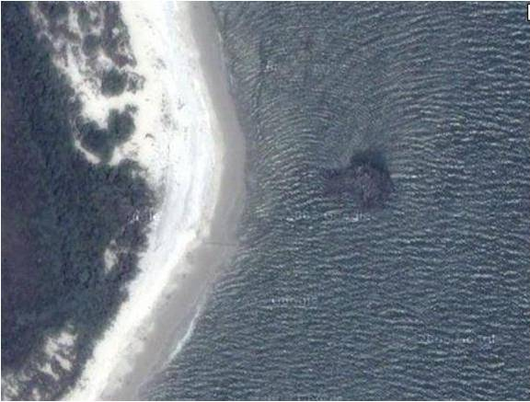
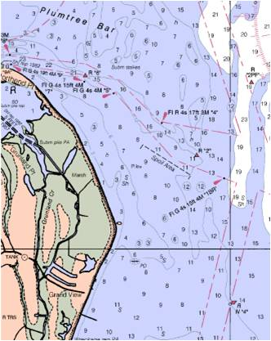
What’s a Chart?
These are the rocks the vessel hit!
Notes:
Chart 12238

Slide 5
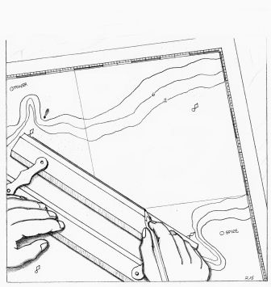
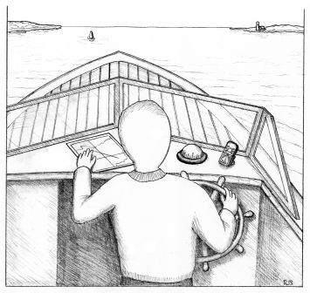
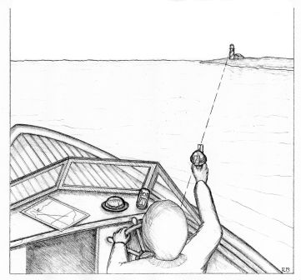
The Three Steps
Pre-voyage Planning
Navigation Underway
Keeping Track & Double-Checking
Fig 2-1

Slide 6
Pre-voyage planning: charts and tools

Slide 7
Chart Elements
Title Block
Projection
Scale
Latitude, Longitude & Distance
Horizontal Datum
Depth Soundings & Contour Lines
Compass Rose
Symbols
Notes:
All this information is necessary to understanding the operation of GPS

Slide 8
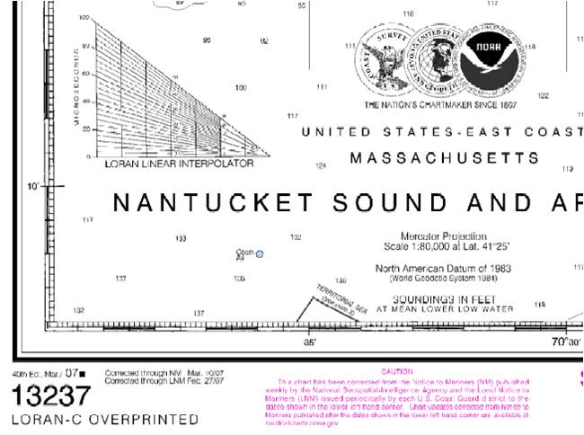
Title Block
Notes:
The Title Block is the focus for the discussion of charts, since most of the chart elements are listed here
Refer the students to Fig 4-1. This image was copied from the “Booklet Charts” provided in PDF at: http://ocsdata.ncd.noaa.gov/BookletChart/
Address Chart Number and Edition. Current chart editions can be viewed at: http://www.nauticalcharts.noaa.gov/mcd/OnLineViewer.html
Regarding the LORAN Interpolator from Wikipedia: In accordance with the DHS Appropriations Act, the U.S. Coast Guard will terminate the transmission of all U.S. LORAN-C signals effective 2000 UTC, 8 February 2010. At that time, the U.S. LORAN-C signal will be unusable and permanently discontinued. This termination does not affect U.S. participation in the Russian American or Canadian LORAN-C chains. U.S. participation in these chains will continue temporarily in accordance with international agreements. The Canadian government has announced that operation of Canadian chains will cease on or before 1 October 2010.

Slide 9
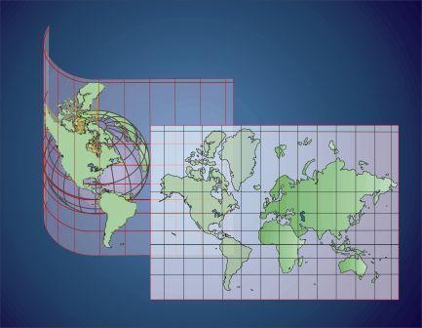
Projections
Mercator Projection
Fig 4-3
Notes:
Lines of longitude Projected parallel.
Angles correctly represented.
The farther from the equator, the greater the distortion.

Slide 10
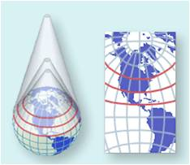
Projections
Polyconic Projection
Notes:
Conic—Mathematically based on an infinite number of cones tangent to an infinite number of parallels.
Used almost exclusively for large-scale mapping in the United States until the 1950's. Now nearly obsolete except for some nautical charts for the Great Lakes areas (e.g., #14902, 14903, et.al.).
Directions are true only along central meridian.
Distances are true only along each parallel and along central meridian.
Shapes and areas true only along central meridian.
Distortion increases away from central meridian.
It is not conformal, perspective, or equal area.
Apparently originated about 1820 by Hassler.
Note: Image from http://www.nationalatlas.gov/articles/mapping/a_projections.html

Slide 11
Chart scale
Notes:
Scale is the second Title Block entry, which is given for a specific Lat. Lat/Long. Will be the next topic.
Discuss scale in general.
Quick click through the scale slides to zoom out from:
Large scale = large detail, used for operating to . . .
Small scale = small detail used for planning.

Slide 12
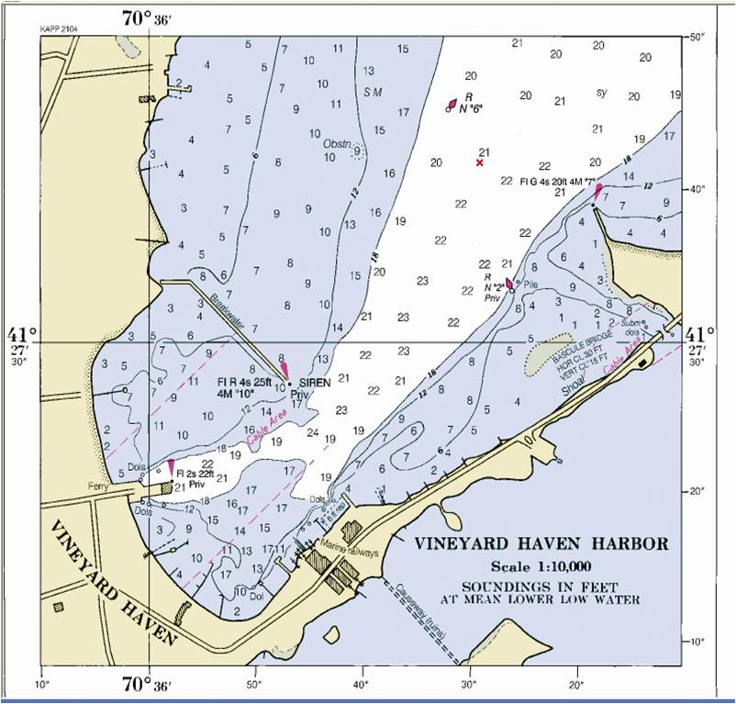
Scale 1:10,000
Fig 4-9

Slide 13
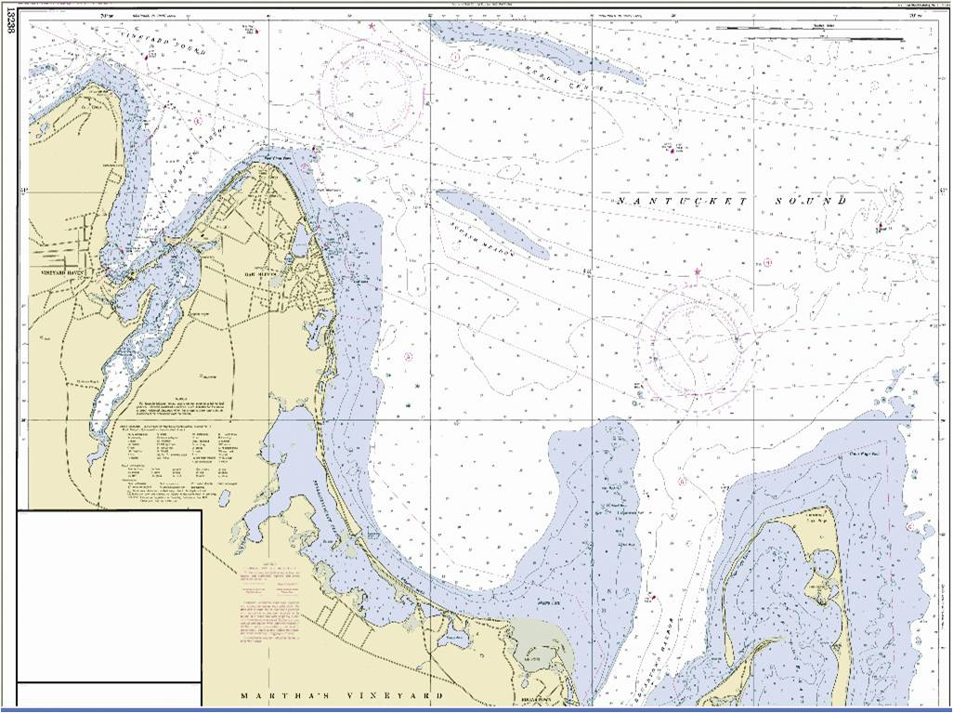
Scale 1:20,000

Slide 14
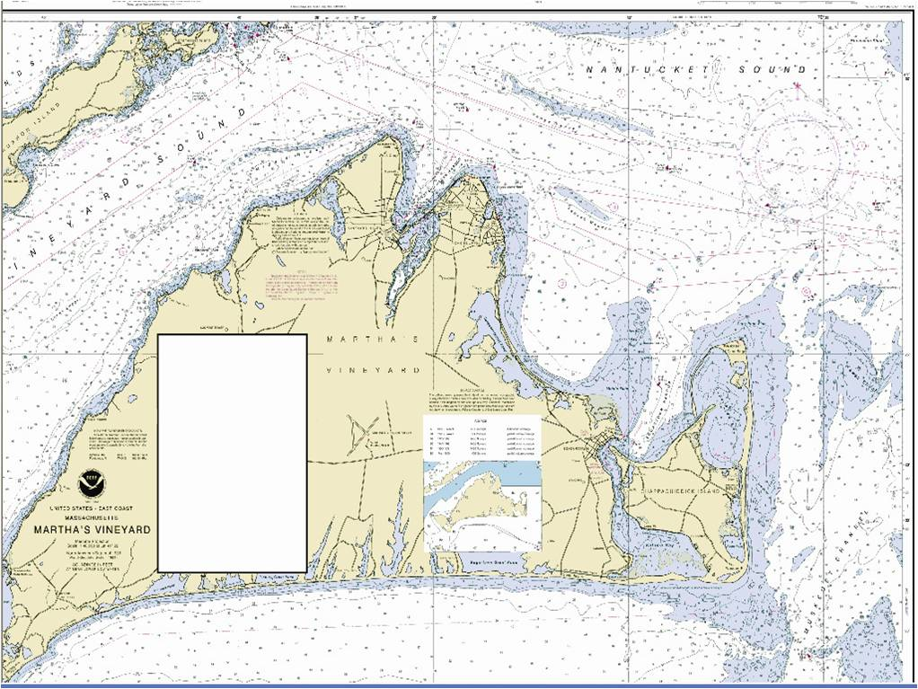
Scale 1:40,000

Slide 15
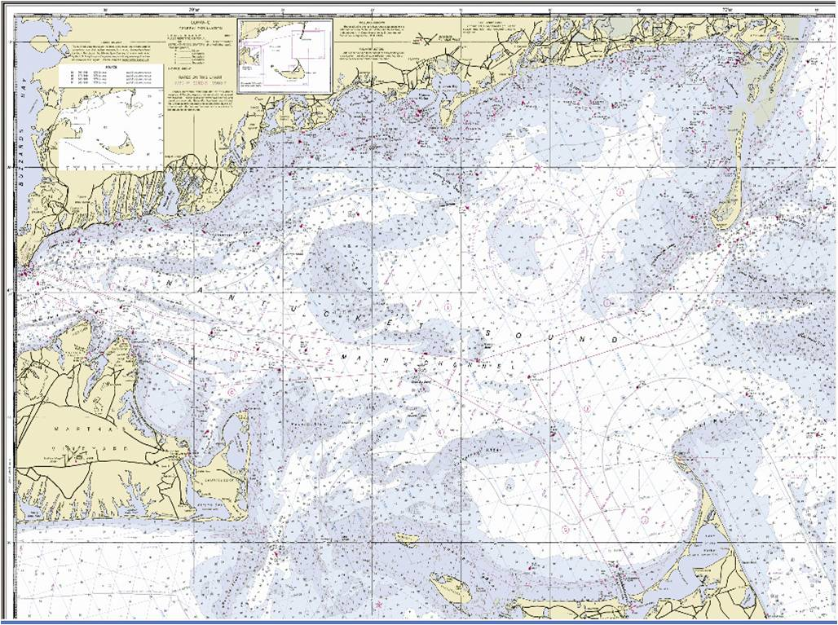
Scale 1:80,000

Slide 16
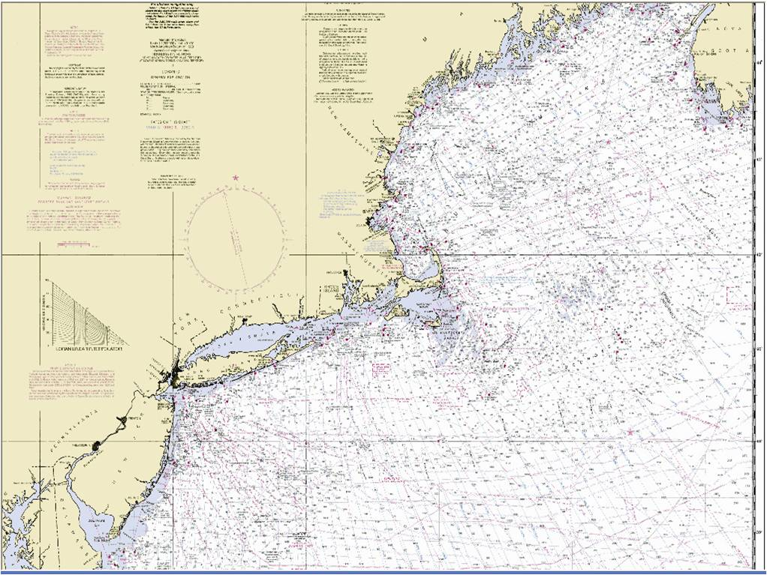
Scale 1:200,000

Slide 17
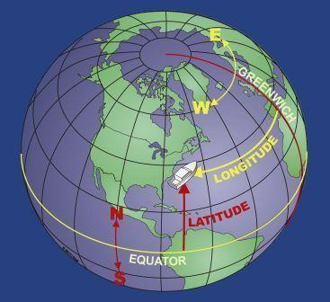
Latitude & Longitude
Fig 4-10
Notes:
General discussion. Class exercise is the next slide where the specifics of identifying Lat./Long. on a chart is demonstrated and practiced.
Meridians: 0° at Prime to 180°, E and W
Equator: 0° at Equator to 90°, N and S
1 Deg = 60 min, 1 min = 60 sec
Formats: Degrees° Minutes’ 10th of minutes / Degrees° Minutes’ Seconds”
Explain how the nautical mile was derived

Slide 18
Class Exercise Lat. & Long.
Use Chart 2 for this exercise
What’s the Latitude (Lat.) of the lower right corner?
41° 27.0’ N
What’s the Longitude (Long.)?
070° 29.4 W
What’s the Lat. and Long. of the left top corner?
41° 33.7’ N 070° 40.0’ W
Notes:
Use this exercise to discuss the specifics of reading Lat./Long. In degrees, minutes and 10ths of minutes. Reading coordinates in degrees, minutes and seconds is addressed in the “Additional Slides” following the presentation.
For courses taught east of 100° longitude, get the students used to entering Longitude using a zero as the first digit. This is a good habit pattern for entering GPS waypoint coordinates.

Slide 19
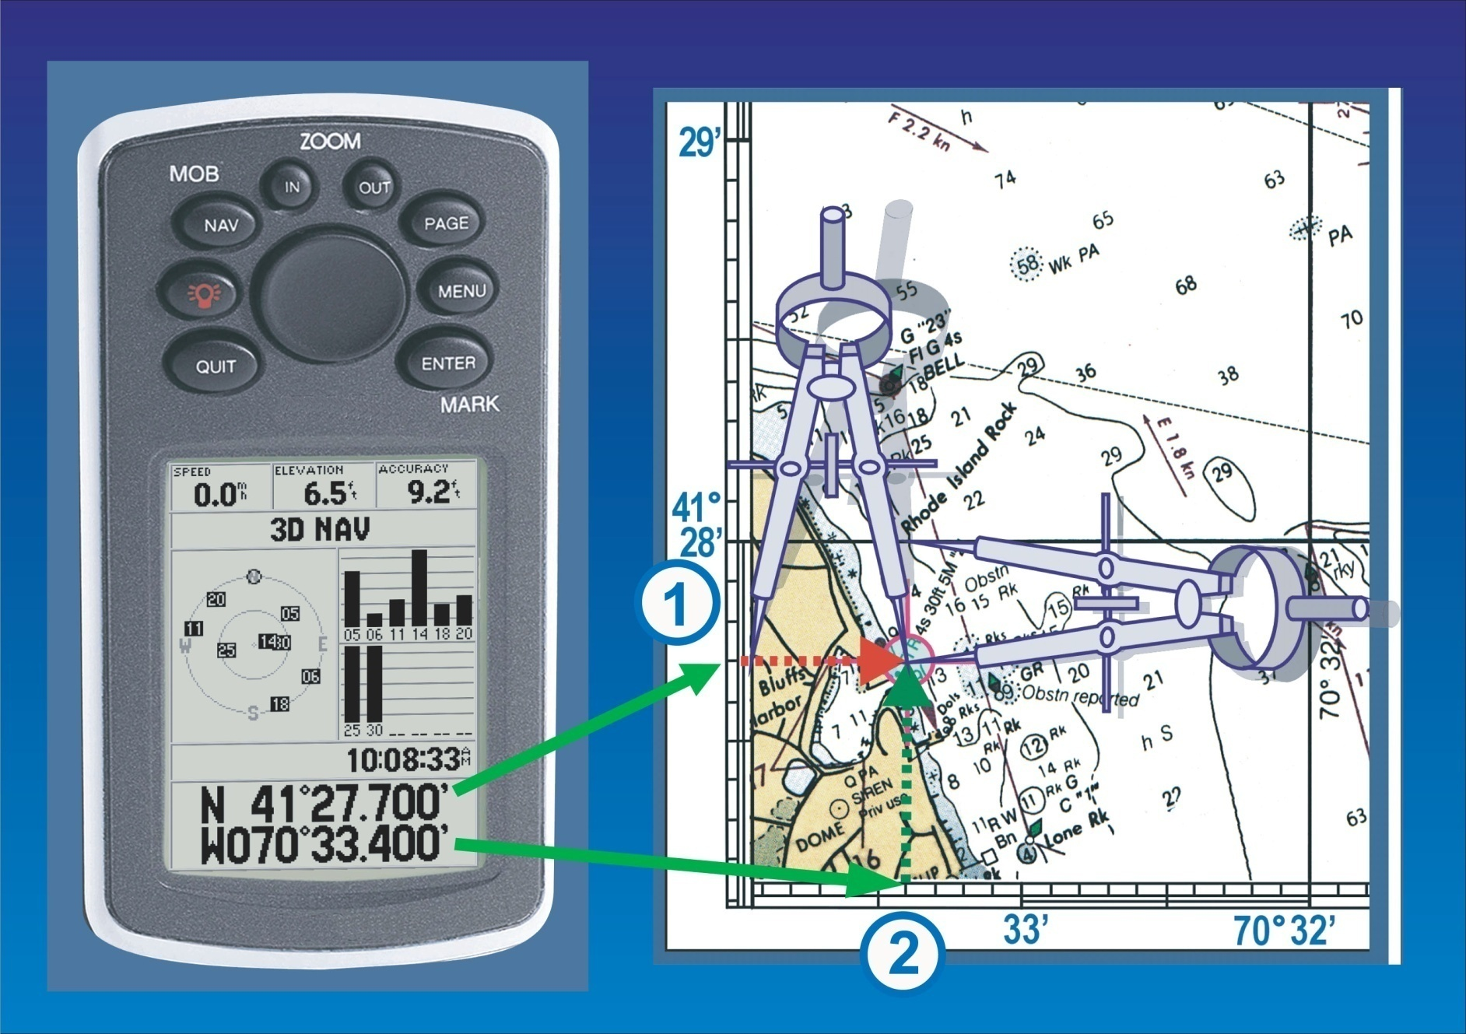
Measuring Lat. & Long.
Fig 4-18
Notes:
Discuss using dividers and, when they are not available, a sheet of paper.
In regions where the Lat./Long. scale is in minutes and seconds, slides showing those measurements are in the “Additional Slides” following the end of the presentation.

Slide 20
Class Exercise Lat. & Long.
Use Chart 2 for this exercise
What is the Lat./Long. of the Oak Bluffs “CUP”? (Cupola; a dome shaped tower or turret on a building)
41° 27.4’ N 070° 34.0’ W
What is the number located at: 41° 30.0’ N 070° 38.4’ W
“77”
Notes:
The student will easily eye-ball that the CUP is a little more then 34.00’. It actually should be 34.02’ (or so).
Traditional navigation measures to the nearest 0.1’, which is the practical limit of our charts, tools, and eyeballs.
Introduce the precision of GPS, which usually measures to the thousandth of a minute.
The GPS is more accurate than the charts and our ability to measure.

Slide 21
Class Exercise Measure Distance
Use Chart 2 for this exercise.
Use a sheet of paper or dividers to measure
How far is it in nautical miles (nm) from bottom to top along the right side?
6.7 nm
How far across the bottom?
7.9 nm
Notes:
The traditional navigation standard of precision is to the nearest 0.1 nm. GPS receivers usually calculate distance to the hundredths of a nm.
A minute is a mile.

Slide 22
Horizontal Datum
Benchmark for Lat. & Long.
North American Datum (NAD) 1983
World Geodetic System (WGS) 1984
Earlier and Other Datums
GPS Setup Requires Datum Data

Slide 23
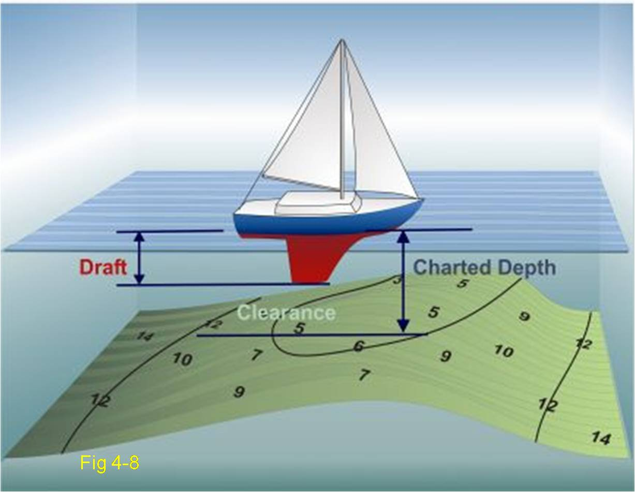
Soundings
Notes:
Note the contour lines

Slide 24
Class Exercise Soundings
Use Chart 2 for this exercise
What are the minimum and maximum depths of the Middle Ground shoal?
6’ and 18’
What are the incremental depths shown by the contour lines?
6’, 12’, 18’, 30’, 60’
On charts, “shallow” areas are shaded blue. If you cruise into a shaded area on this chart, the charted depth will be . . .
18 feet or less
Notes:
Discuss:
Datum at MLLW. Tides will be discussed in Session 4.
There will probably be a difference between the charted soundings and what the depth actually is, because the chart is based on hydrographic surveys going a long way back, sometimes to pre-1900.
Source Diagrams
Effect of weather (winds, atmospheric pressure, rain, etc.)
Increments of 6’ are fathom contour lines.

Slide 25
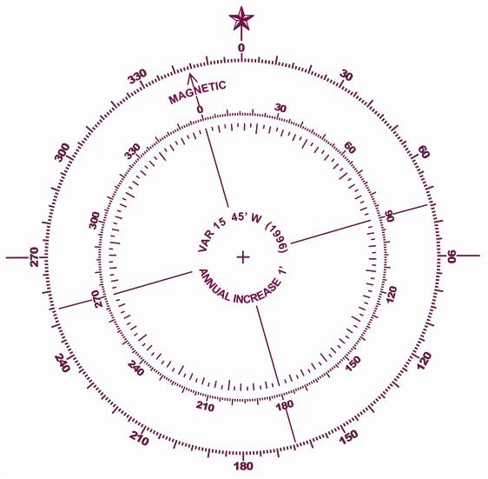
The Compass Rose
Fig 5-15
Notes:
Now transition from the Title Block information to the other chart elements.

Slide 26
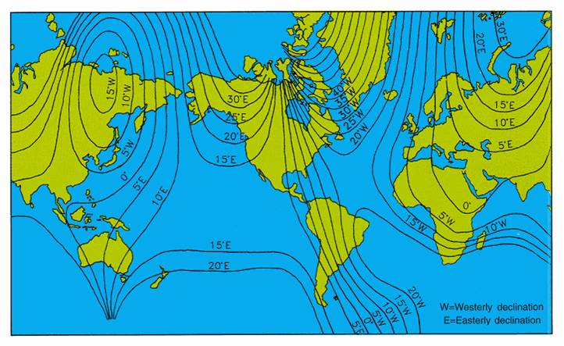
Notes:
Discuss Magnetic North.
Use the next slide, to further illustrate isogonic lines and why the compass needle is pulled E and W as one’s location changes across the US.
An interesting feature is the innermost rose, which gives the 32 compass points and quarter points.

Slide 27
Variation is Local
Fig 5-15
Notes:
Discuss the Variation within your cruising area.
Basic GPS requires entering the local variation. GPS with charts automatically knows the variation

Slide 28
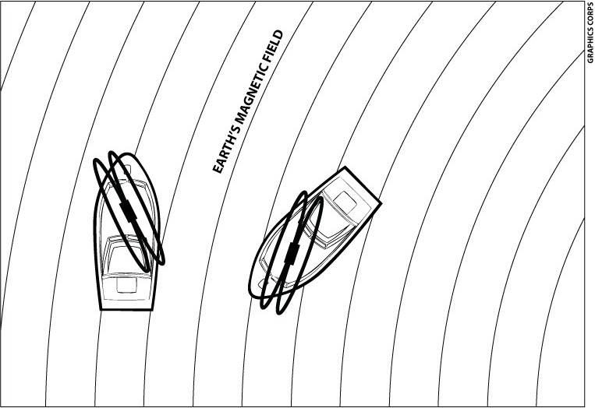
Compass Deviation
Fig 4-26
Notes:
The vessel’s deviation magnetic field is oriented 340°-160° relative to boat.
Deviation is the result of the compass responding to the interaction of the two magnetic fields.
As the vessel turns and its field aligns with the earth’s field, deviation becomes zero.

Slide 29
Compass Deviation
Most boats have negligible deviation
Some boats have severe deviation
Often caused by portable items--speakers, fans, radios
Can be measured and accounted for
Notes:
A speaker 20 ft. from compass can cause problems.
Orientation of the item changes the effective deviation.
Chapter 28 has a detailed explanation of how to determine deviation. Unless time is not a constraint, avoid a long a long discussion on those techniques here.
Will work with deviation in Session 3.

Slide 30
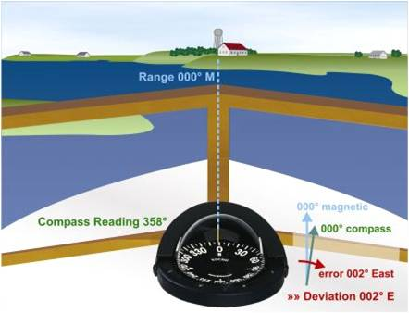
Compass Deviation
Fig 11-6
Notes:
A useful example of how deviation affects the compass.
A quick deviation check can be accomplished using a range. Relative bearings will be addressed in session three.

Slide 31
Correcting for Variation and Deviation
START
Tele-
T
True Bearing 005°
Vision
V
Variation 016° W
Makes
M
Magnetic Bearing 021°
DOWN
ADD
WEST
Dull
D
Deviation 003° E
Children
C
Compass Bearing 018°
Add Wonder (Add West)
Notes:
Traditional navigation memory device, taken from the BS&S course, Chapter 9.
Can be Bearings, Headings, or Courses.
GPS is immune from deviation. That’s why compass readings may differ from GPS heading

Slide 32
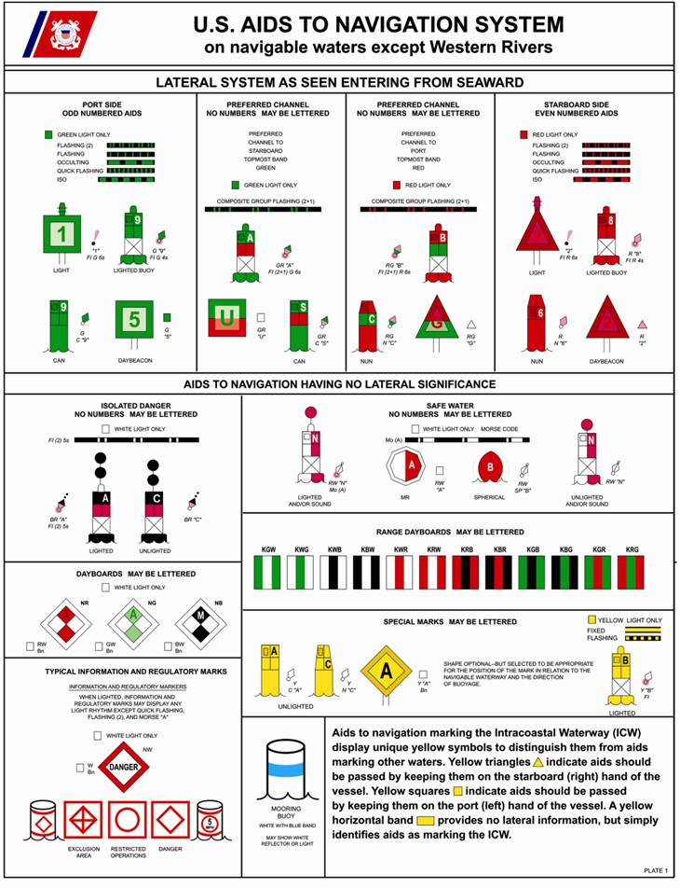
Symbols: Aids to Navigation
Fig 4-15A
Notes:
Introduce the students to Figures 4-15A thru D. Figure 4-15A will be used in the next class exercise.
The pamphlet “U.S. Aids To Navigation System,” ANSC 3022, is a great handout for those students who have not taken BS&S or S&S.

Slide 33
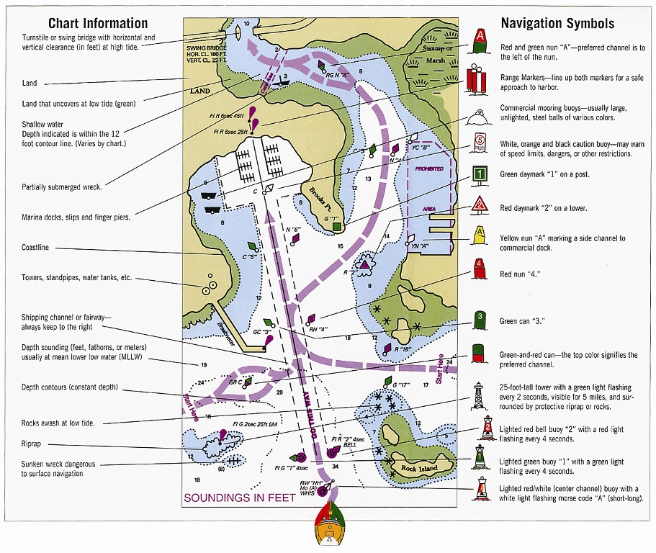
Fig 4-11
Notes:
This view is congested, but illustrates the systematic way charts depict important object, locations, and information.

Slide 34
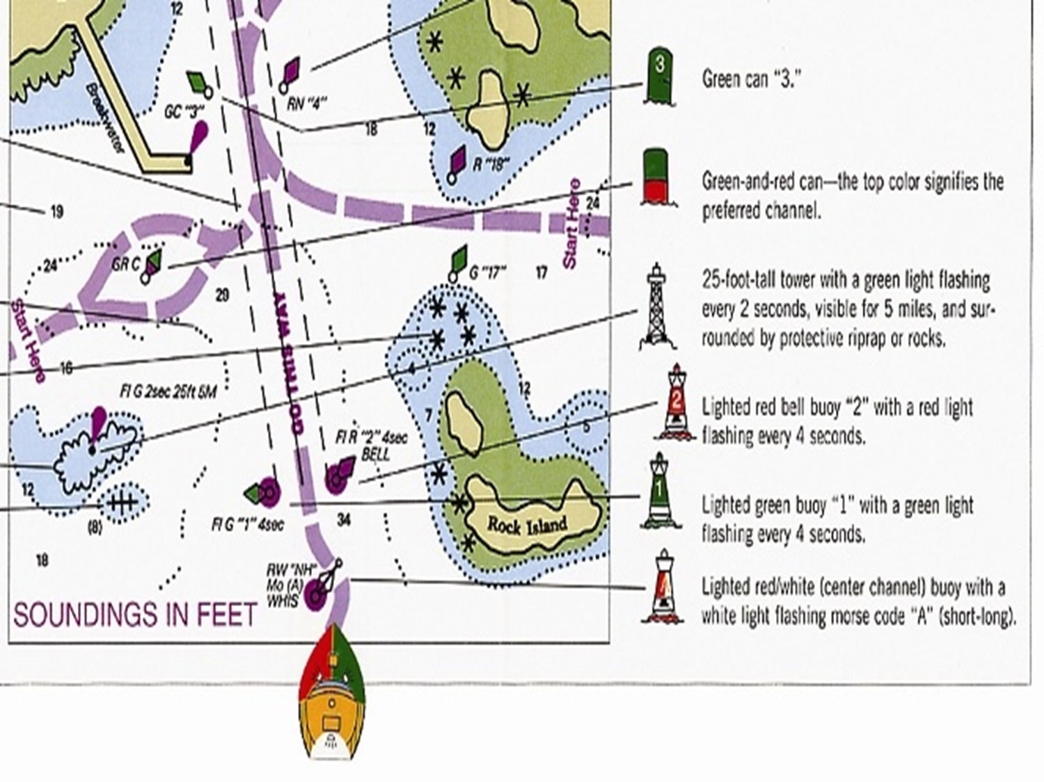
Notes:
Use a “cruise” up channel to discuss ATONs.

Slide 35
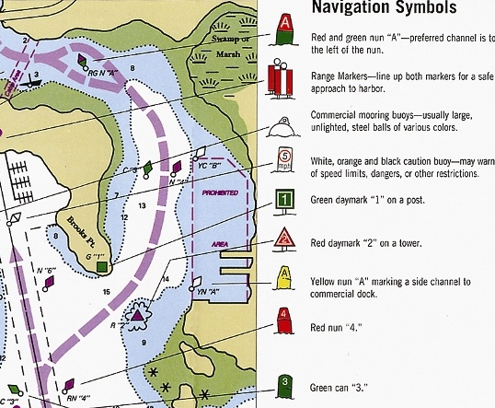

Slide 36
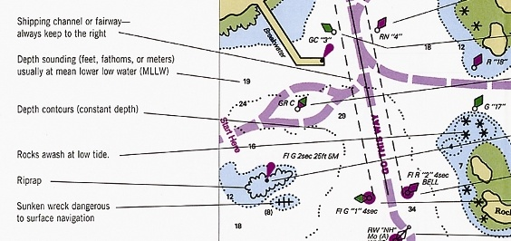
Chart Symbols
Notes:
Discuss:
Chart No. 1. Available on-line. Recommend having a hardcopy on hand.
Bridges– Clearances published are at MHW.
Prominent features such as charted objects on land and moorings.
Hazards such as rocks, shoals and wrecks.

Slide 37
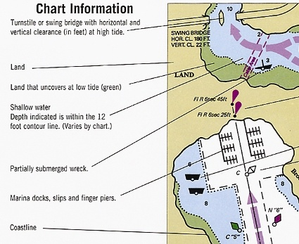

Slide 38
Class Exercise: ATONs
Use Chart 3 and the top half of Figure 4-15A for this exercise. What ATON is located at:
41° 29.2’ N 070° 36.1’ W
GC “25” unlighted Green Can buoy number 25
41° 27.5’ N 070° 35.8’ W
FL R 4s 4M “10” lighted beacon Flashing Red every 4 sec Visible for 4 Miles number 10
41° 32.4’ N 070° 29.5’ W
R “12” FL R 2.5s lighted Red buoy number 12 Flashing Red every 2.5 sec
Notes:
This exercise builds upon the Lat./Long. measuring techniques along with basic ATON symbol interruption.

Slide 39
Navigator’s Tools
Dividers
Parallel Rules
Rolling Parallel Rule
Protractor Plotting Tool
Magnetic Compass
GPS
Notes:
The students may have already used these tools for the previous exercises. Discuss the advantages and use of these tools as the slides appear.

Slide 40
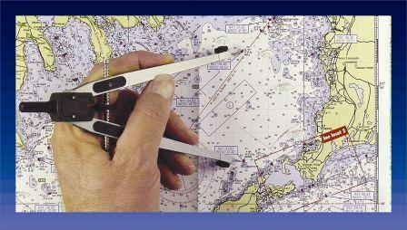
Dividers
Fig 4-17A
Notes:
Note the Vernier on the dividers is to enable tiny adjustments

Slide 41
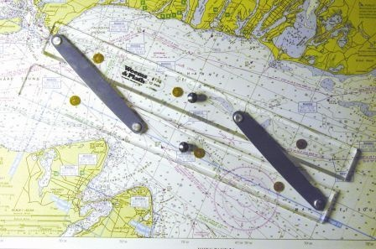
Parallel Rules
Fig 4-20

Slide 42
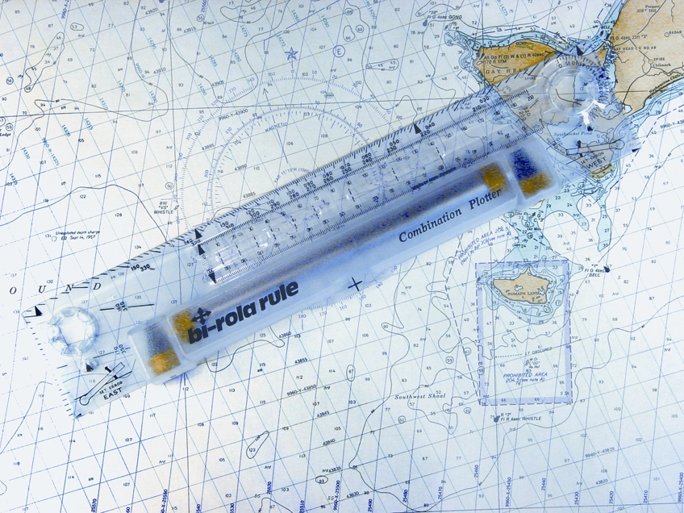
Rolling Parallel Rule
Fig 4-22

Slide 43
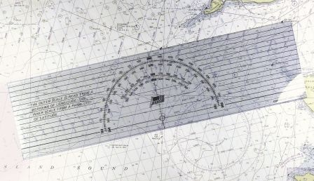
Protractor Plotting Tool
Fig 4-23

Slide 44
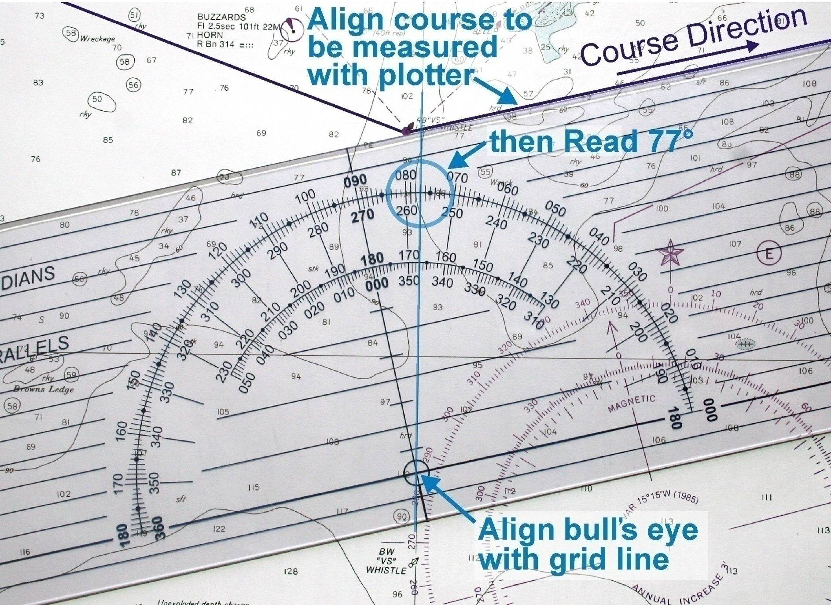
Using the Protractor Plotter
Fig 4-24
Notes:
Discuss practicality of using plotters on small charts versus a large flat table

Slide 45
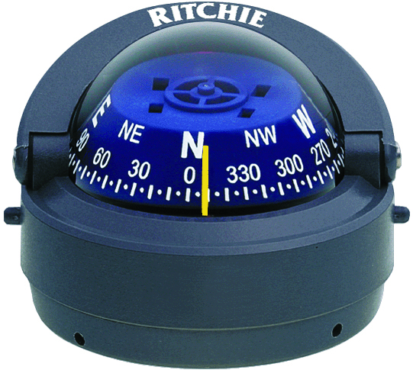
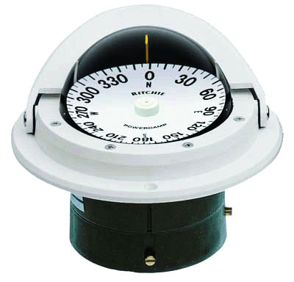
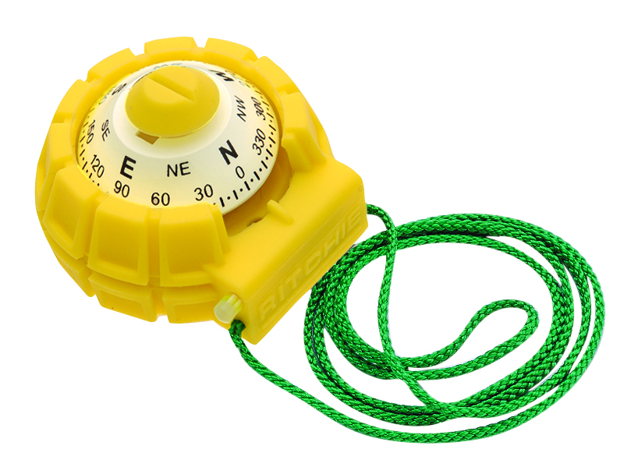
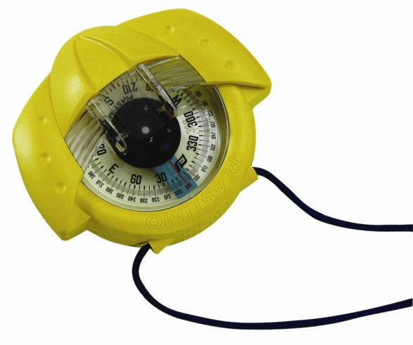
Magnetic Compass
Notes:
Discuss both ship’s compass (front and back reading) and hand bearing compass as tools.

Slide 46
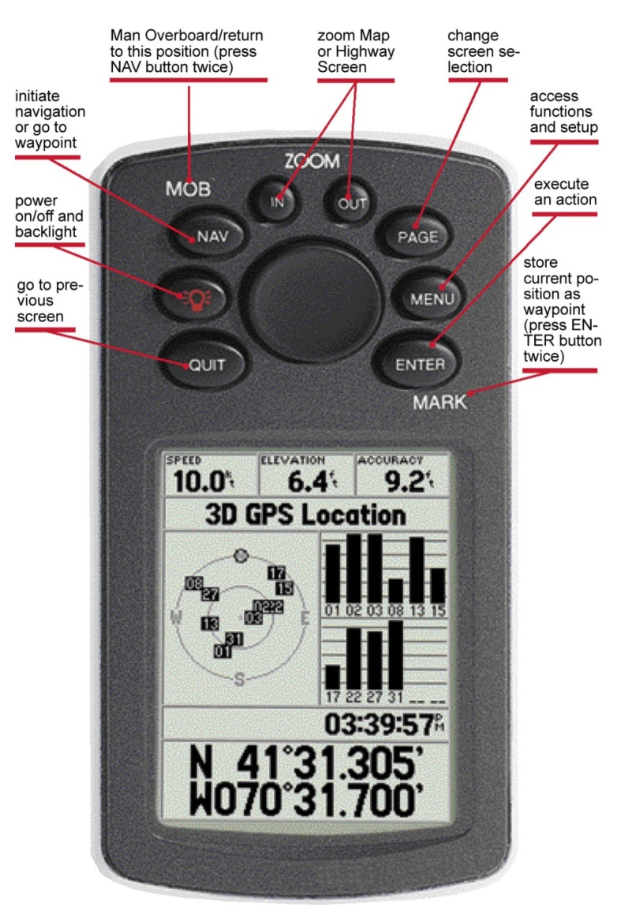
Meet your GPS
24/7 system to give position and more
Receivers capable of providing real time navigation information and chart displays
Discussed later in course
Notes:
This slide is for the benefit of students who know little about GPS. GPS is covered more thoroughly in Session 3.
Use this opportunity to emphasize that learning these navigation terms will be critical in understanding how the GPS works.

Slide 47
Plotting a Course
Determine leg start and end points
“Prequalify” the course for hazards
Safe Depths
Isolated Hazards
Shoals
Horizontal Clearance
Clearance Overhead

Slide 48
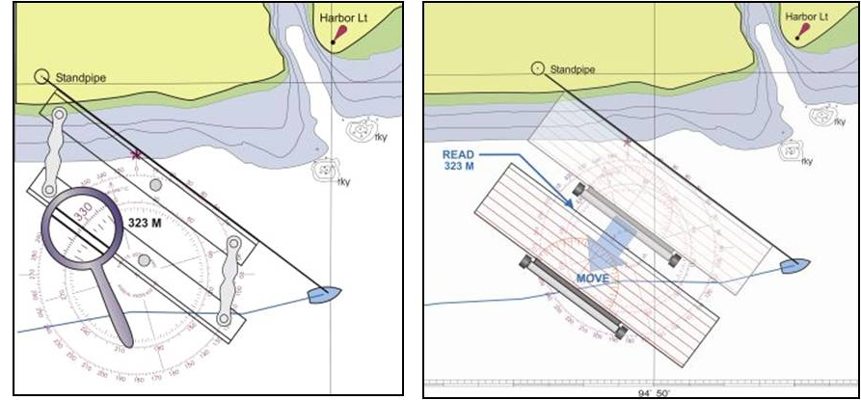
Plotting a Course
Draw the course line
Move the line to a compass rose and determine the magnetic (M) course
Measure the distance between points
Note the course/distance on the chart or in a log.
Be Careful with the numbers!
Notes:
Many planning errors are due to not carefully moving the course to the rose, reading the direction on the T rose instead of the M rose, or reading the reciprocal of the desired course.
In the absence of navigation tools, fairly accurate course measurement can be made using a sheet of 8.5 x 11 paper and a straightedge.
Place the long edge of the paper along the course line and an intersecting longitude Line. If a longitude line isn’t convenient, use the straightedge to keep the paper edge aligned with the course, and slide the paper to one. A latitude line can also be used.
Hold the paper securely in place and align the straightedge with the longitude line and across the paper. Strike a line with a pencil on the paper.
Place the straight edge to align with the 000 and 180 tick marks on the magnetic rose.
Move the paper edge to the center of the compass rose and adjust it under the straightedge so the penciled line is aligned with the straight edge.
Read the magnetic course under the paper edge at the appropriate side of the M rose.

Slide 49
Class Exercise Chart Work
Use Chart 3 for this exercise. This is a cruise planned from R “12” at the upper right and continuing counter-clockwise:
Verify the magnetic courses and distances given for each leg of the cruise.
Look for errors.
Notes:
The magnetic courses shown for Legs 4 and 6 are incorrect. The intent is that students gain confidence in their ability to correctly measure course lines in Legs 1-2, and be able to recognize and correct an error when they are presented with one.

Slide 50
Session 1 Homework Cruise Exercise #1 Read Chapters 1-5 & 10
Notes:
Consult Student Guide
Discuss homework and expectations for next session.

Slide 52
Additional slides
Notes:
Optional slide that the instructor may insert into the presentation

Slide 53
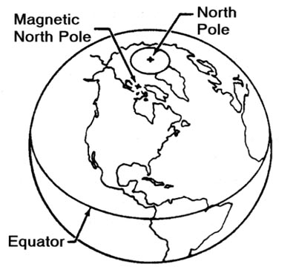
Relative Positions of Poles
T
M

Slide 54
Relative Positions of Poles
T
M
x
Variation

Slide 55
The Weekend Navigator
Measure Lat. & Long. in the
Degree / Minutes / Seconds
Format

Slide 56
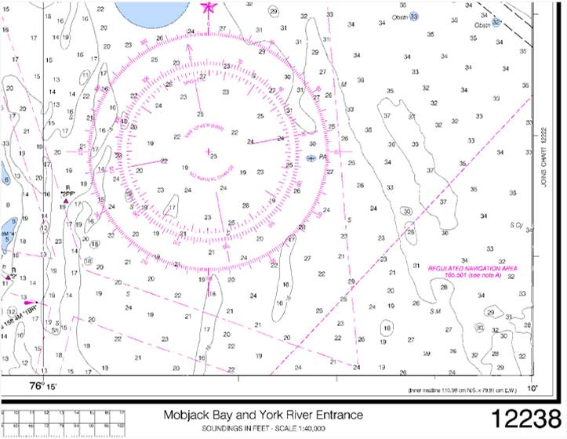
37° 08’
Minutes
76° 12’

Slide 57
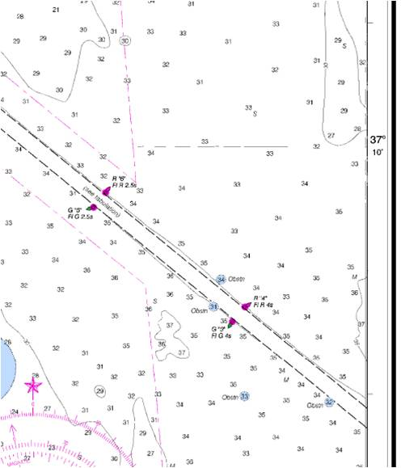
37° 11’
37° 09’
37° 08’

Slide 58
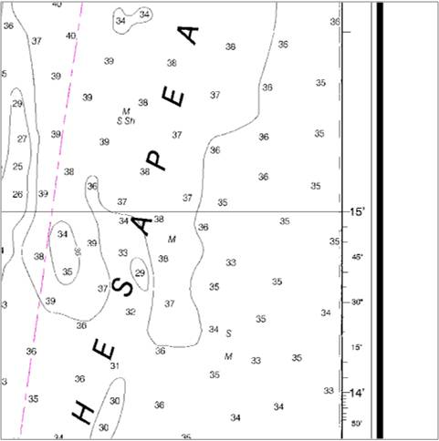
60” Seconds
10”

Slide 59
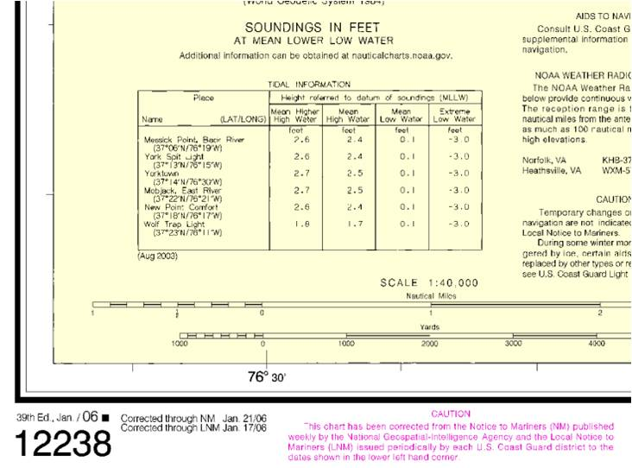
76° 31’ ??”
??”

Slide 60
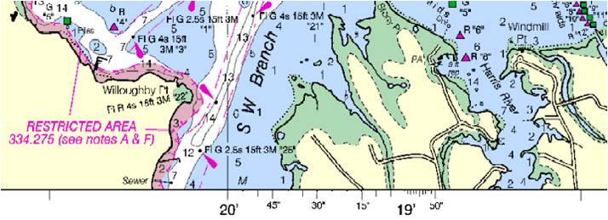
35”
10”
60”

Slide 61
76° 31’ 35”
35”

Slide 62
Lat. & Long. Formats
37° 30.25’
Degrees / Minutes & 10th of Minutes
37° 30’ 15”
Degrees / Minutes / Seconds
Convert Seconds to 10th of Minutes: Divide by 60
15 seconds = 15 ÷ 60 = .25
30 seconds = 30 ÷ 60 = .50
45 seconds = 45 ÷ 60 = .75
Convert 10th of Minutes to Seconds: Multiply by 60
Notes:
When using charts in the Degree/Minutes/Seconds format, the GPS default (Degree/Minutes & 10th of Minutes) can be reset.

Slide 63
End additional slides

